Slide 1
Secondary electron detectors
Anderson Thesing – January, 2013

Slide 2
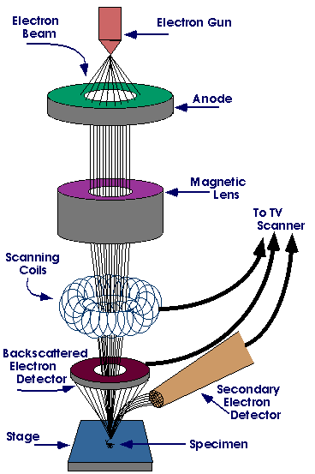
Principle of the SEM
The SEM is an instrument that scans a sample surface with a finely converged electron beam in a vacuum, detects the signals produced at that time from the sample, and presents a image of the surface of the sample.

Slide 3
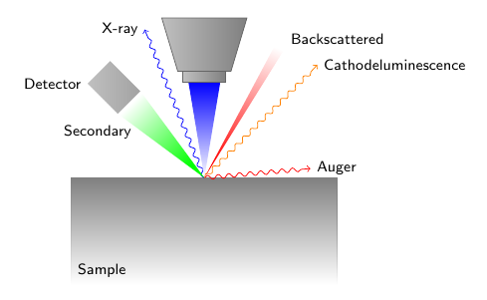
By irradiating the sample with an electron beam in a vacuum, secondary electrons, backscattered electrons, x-rays and other signals are generated. For the SEM image, secondary electrons and backscattered electrons are used.

Slide 4
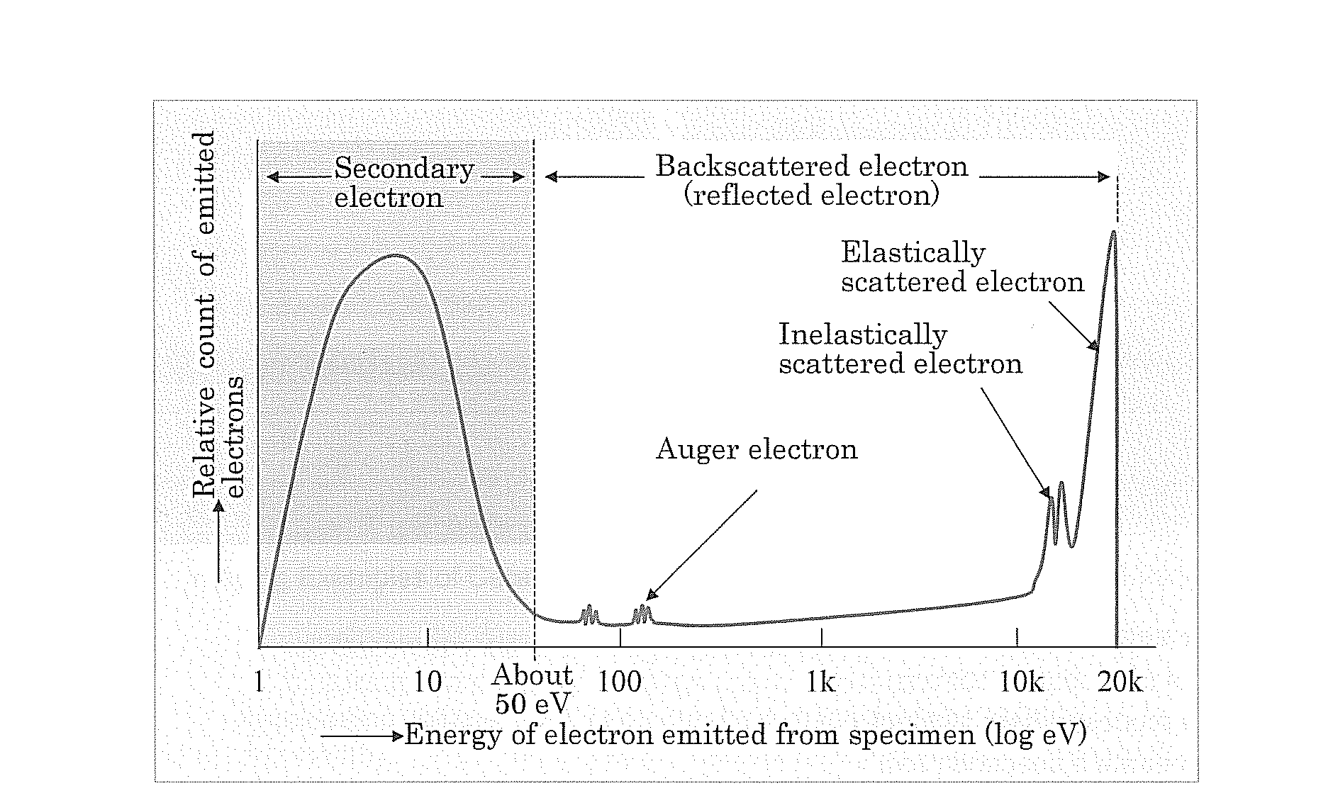
Secundary electrons (SE)
SE are produced near to surface of the sample, and the SE image obtained upon detecting these electrons reflects the fine topographical structure of the sample.
SE have a very small energy emitted(≥50 eV), therefore, a high resolution image is expectable from the SE signals.

Slide 5
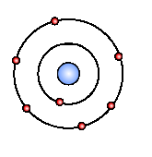
There are 3 types of SE:
SE1: First kind of secondary electrons are generated by the incoming electron beam as they enter the surface. The resulted image has high resolution which is only limited by the electron beam diameter.

Slide 6
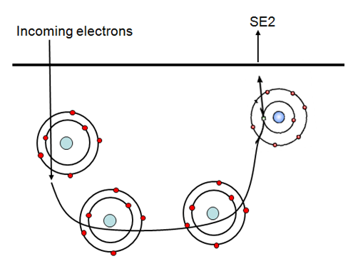
SE2: The secondary electrons that are generated by the backscattered electrons have returned to the surface after several inelastic scattering events. SE2 come from a surface area which is bigger than the spot of the incoming electrons , also bigger than surface area of SE1. Therefore resolution is less than resolution of SE1.

Slide 7
SE3: The generator of this kind is the SE2 that enters the lens surface and get scattered. Thus, it will result in a decrease of resolution.

Slide 8
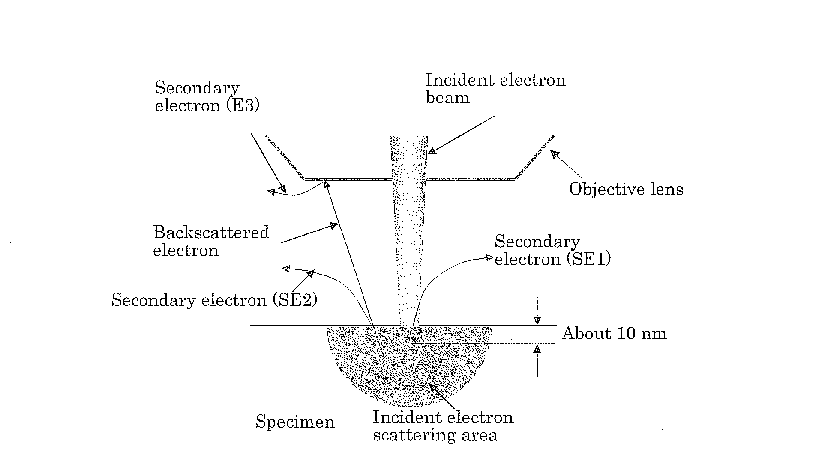

Slide 9
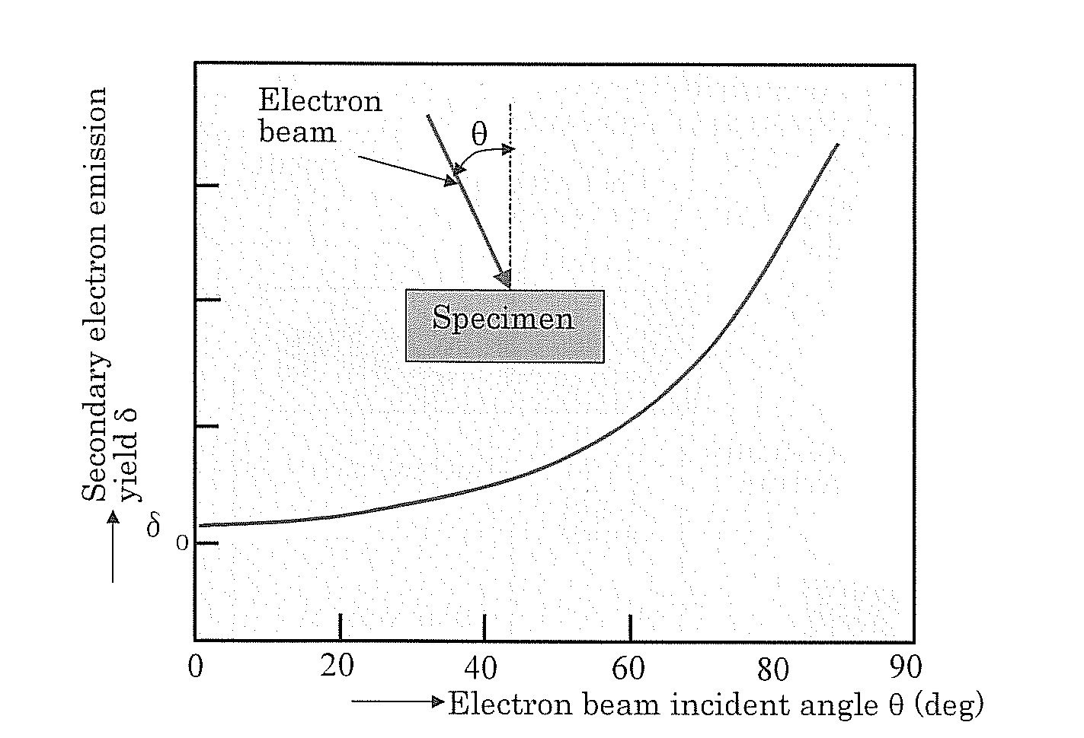
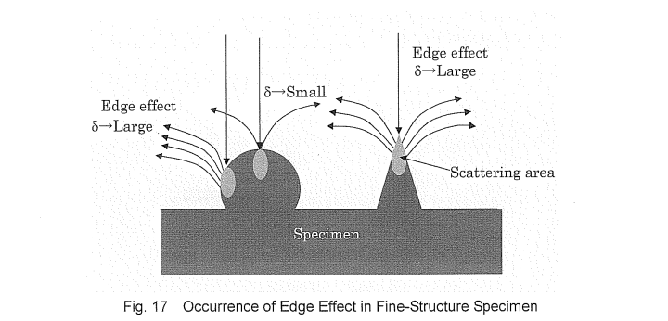
Factors that affect the SE emission
Atomic number (Z): when the Z increase, the emission of SE increase too.
Incident angle of electron beam

Slide 10
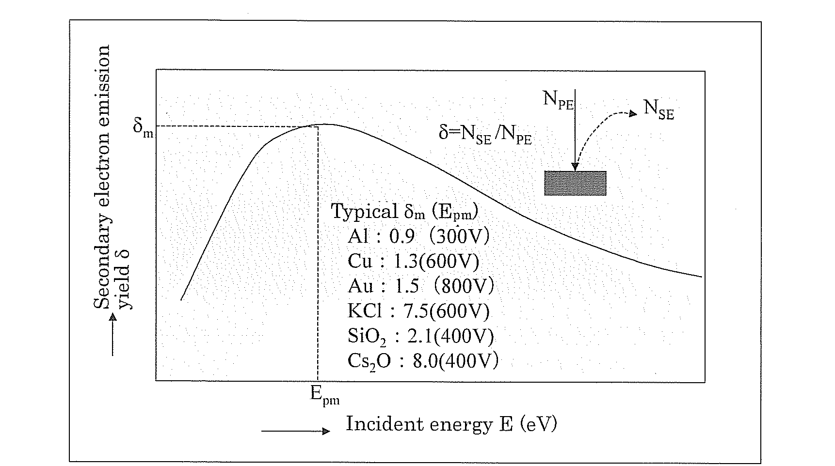
Factors that affect the SE emission
Energy beam: the maximum emission of the SE depends of the specimen.
Electron emission yield $δ= \frac{N_{SE}}{N_{IE}}$

Slide 11
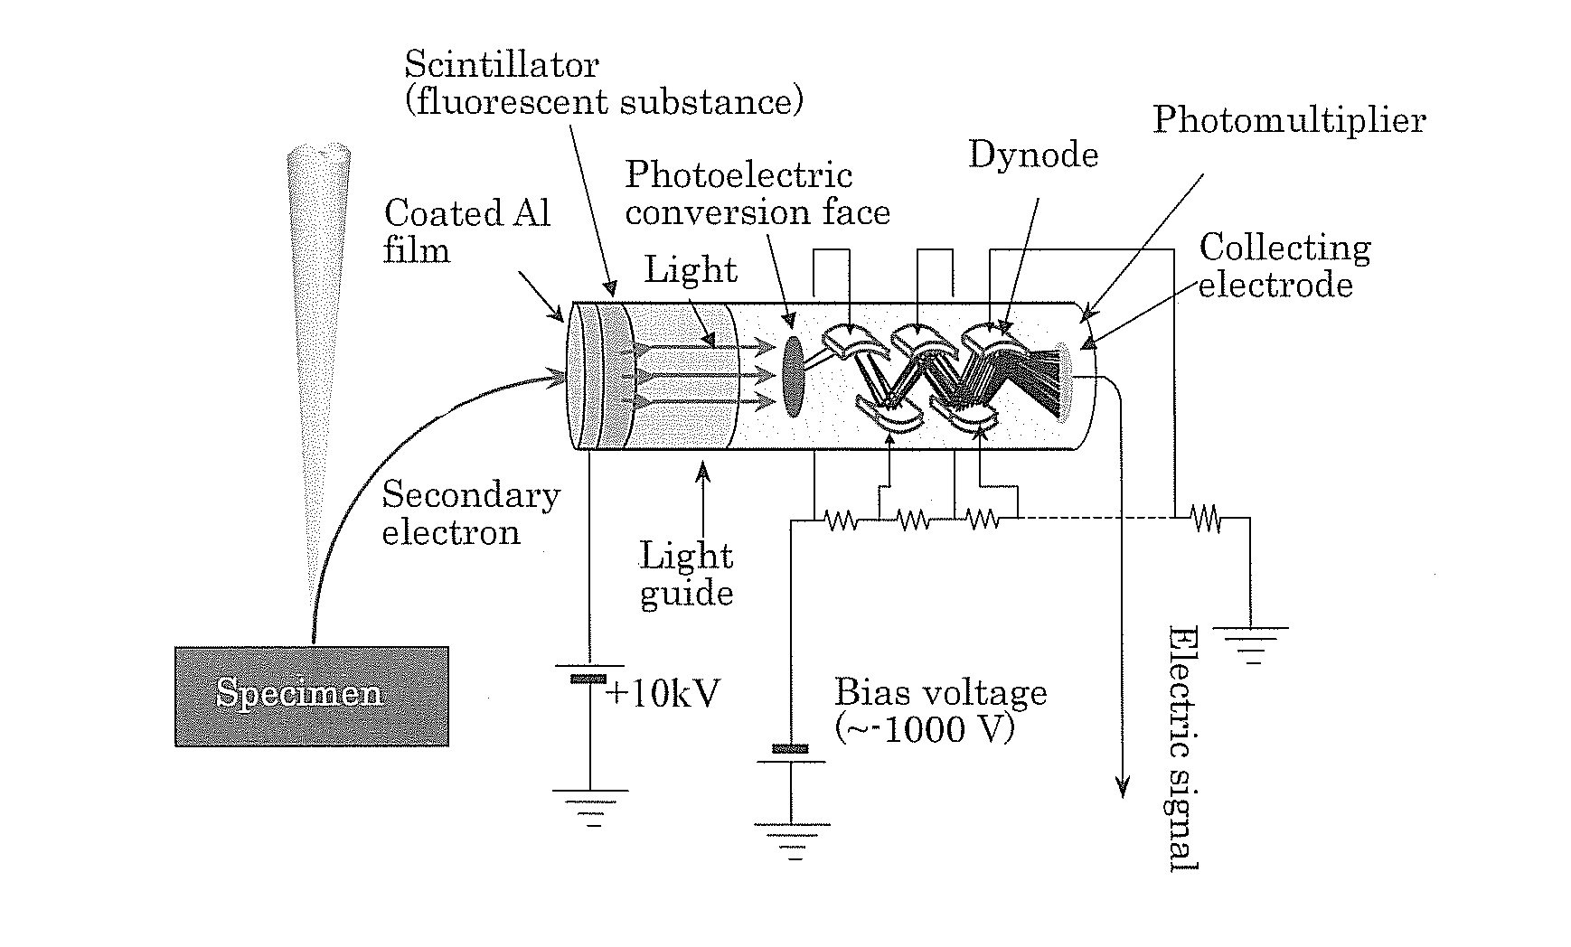
Everhart and Thornley detector
Long service life
Fast response speed

Slide 12
In summary: A SEM image generally refers to a secondary electron image. This image is indispensable particularly for high resolution observation, based on the information source of secondary electron is shallow and small.

Slide 13
Thank you!

